Slide 1
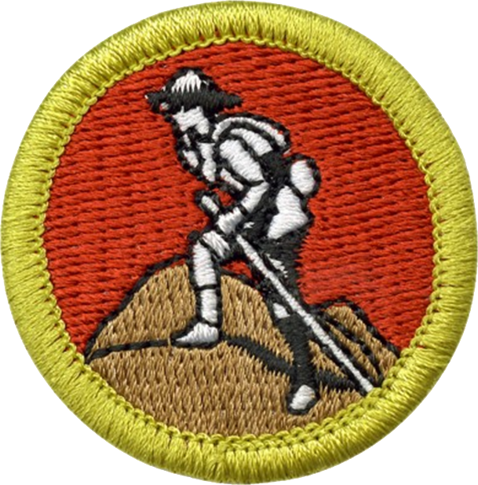
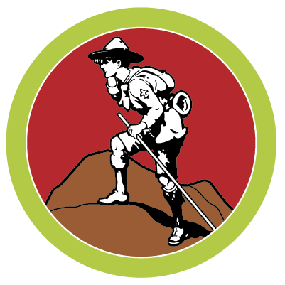
Scouting Heritage Merit Badge
“You can't know where you're going until you know where you've been”

Slide 2
Scouting’s Legacy
Video: Click on black object

Slide 3
Robert Baden-Powell
Born: Robert Stephenson Smyth Powell in London on February 22, 1857.
His father was Rev. Baden Powell. Father died when Robert was 3 years old.
As a tribute to Rev. Powell, the family name was changed to Baden-Powell.
In Scouting, usually known simply as “BP”.
In 1929, was created Baron Baden-Powell, of Gilwell. Thereafter known as Lord Baden-Powell

Slide 4
Robert Baden-Powell
Video: Click on black object

Slide 5
More on BP
He enhanced and honed his military scouting skills amidst the Zulu in the early 1880s in South Africa.
Engaged in Second Boer War. Defended town of Mafeking in South Africa for 217 days while being completely outnumbered by the Boers.
Used deception: fake mine fields, non-existent barbed wire.
Once relieved by reinforcements, BP became known as the “Hero of Mafeking”.

Slide 6
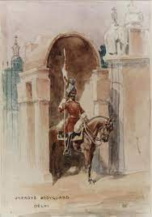
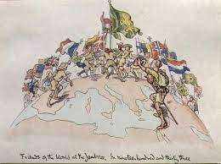
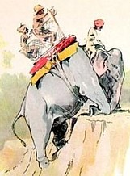
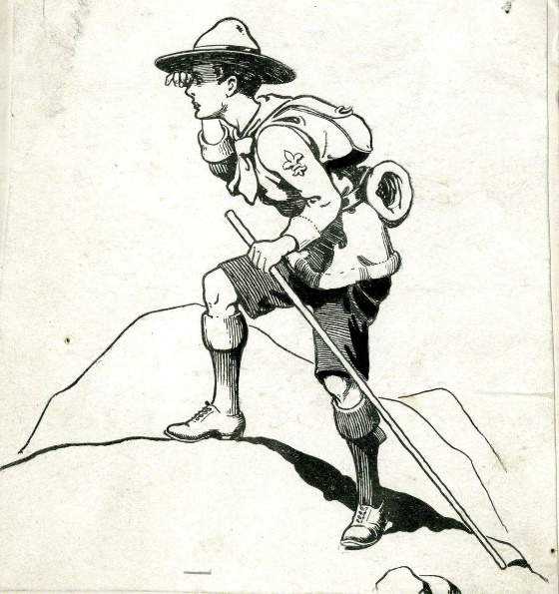
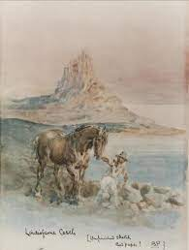
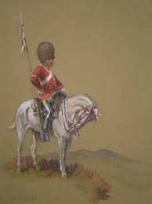
More on BP
Accomplished artist

Slide 7
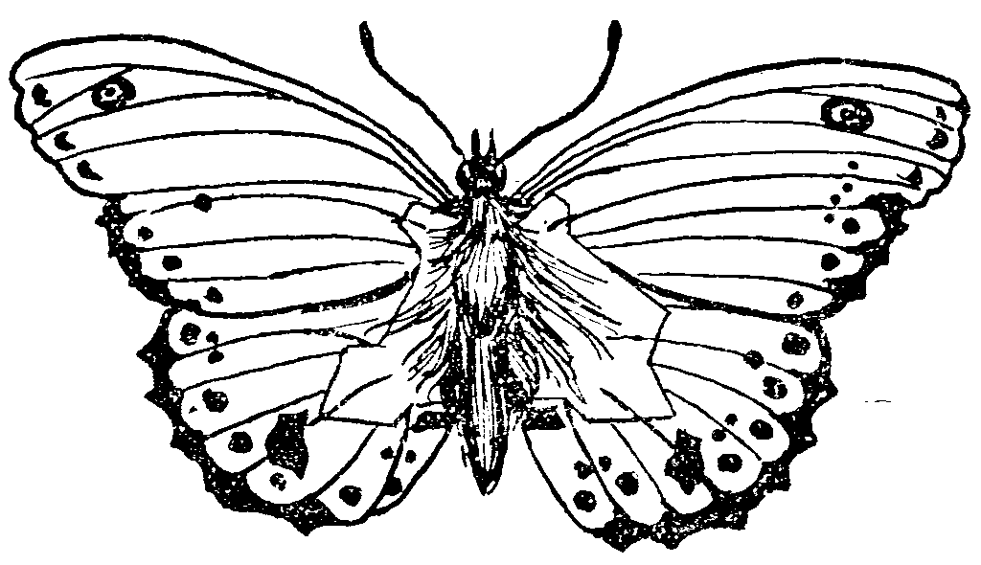
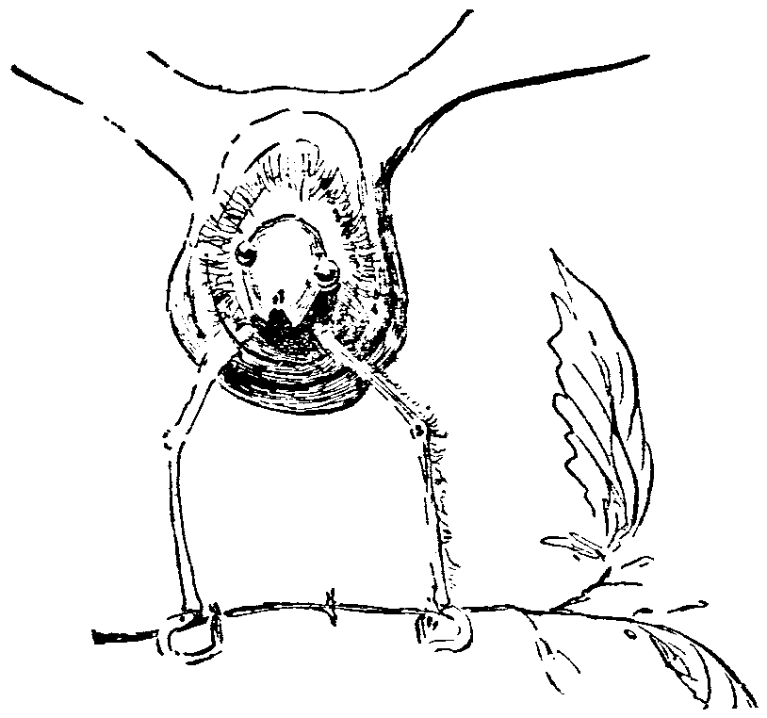
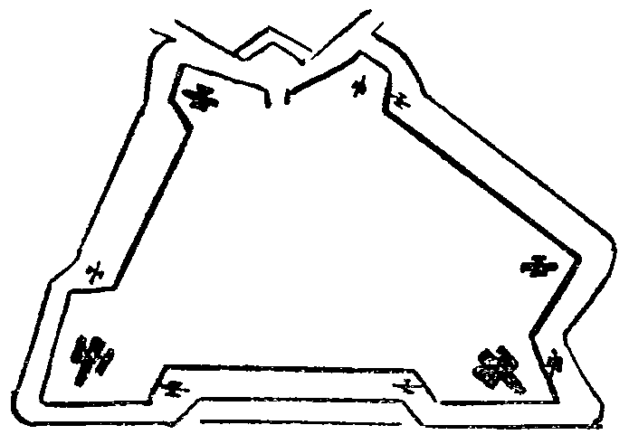
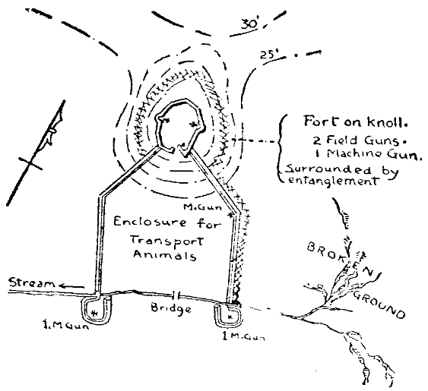
More on BP
Would often travel in disguise, as a butterfly collector, to spy on other military.
“Hid” his findings in sketches of butterfly wings.

Slide 8
Aids to Scouting
On his return from Africa in 1903, Baden-Powell found that his military training manual, Aids to Scouting, had become a best-seller, and was being used by teachers and youth organizations.
Baden-Powell decided to re-write Aids to Scouting to suit a youth readership (now called Scouting for Boys).
In August 1907 he held camp on Brownsea Island for twenty-two boys of mixed social background to test out the applicability of his ideas.

Slide 9
The Scouting Movement
In 1910 Lieutenant-General Baden-Powell decided to retire from the Army on the advice of King Edward VII, who suggested that he could better serve his country by promoting Scouting.
Boys and girls spontaneously formed Scout troops and the Scouting Movement had inadvertently started, first as a national, and soon an international obsession.

Slide 10
Girl Guides/Scouts
The Girl Guide Movement was subsequently founded in 1910 under auspices of Baden-Powell's sister, Agnes Baden-Powell.
Baden-Powell's friend, Juliette Gordon Low, was encouraged by him to bring the Movement to America, where she founded the Girl Scouts of the USA.

Slide 11
More on Baden-Powell
At 1st World Scout Jamboree in 1920, BP was proclaimed Chief Scout of the World.
At 5th World Scout Jamboree in 1937, BP gave his farewell to Scouting, and retired from public Scouting life.
Baden-Powell died on 8 January 1941 and is buried in Nyeri, Kenya, in St. Peter's Cemetery. His gravestone bears a circle with a dot in the center, which is the trail sign for "I have gone home."

Slide 12
Other Important People
William D. Boyce
Brought Scouting to United States in 1910
Daniel Carter Beard
Sons of Daniel Boone – merged with BSA
Ernest Thompson Seton
Woodcraft Indians – merged with BSA
James E. West
1st Chief Scout Executive for 30+ years
Waite Phillips (Phillips Petroleum – Phillips 66)
Built Villa Philmonte in Northern New Mexico as his summer home, which was later donated to BSA as Philmont Scout Ranch.

Slide 13
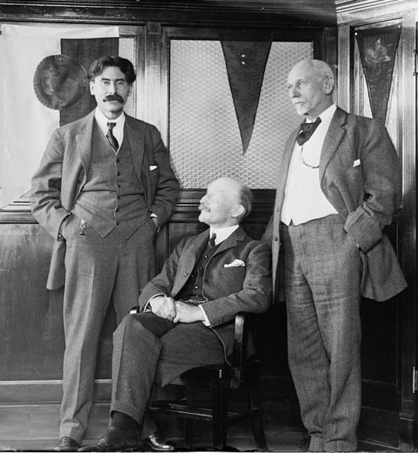
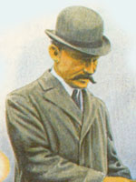
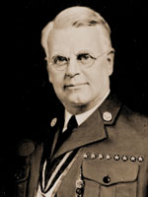
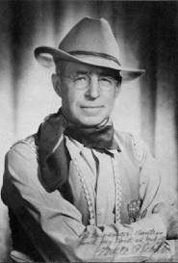
Other Important People (cont)
Boyce
West
Seton
Baden-Powell
Beard
Phillips

Slide 14
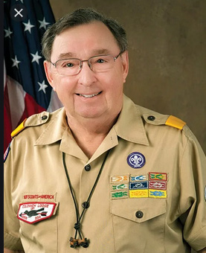
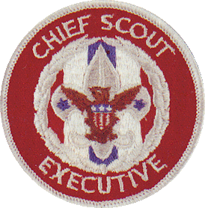
Other Important People (cont)
Roger C. Mosby
(current Chief Scout Executive)

Slide 15
Brownsea Island
Small island off the coast of southern England
Baden-Powell had visited the site as a boy with his brothers
Birth of Scouting in August 1907
20 Boys arranged in 4 patrols: Wolves, Ravens, Bulls and Curlews
Boys received brass fleur-de-lis badges, the first use of the Scout emblem, and colored knot on shoulder indicating patrol.
After passing tests on knots, tracking, and the national flag, given another brass badge, a scroll with the words Be Prepared, to wear below the fleur-de-lis
World Jamborees held in 1973 and 2007

Slide 16
World Jamborees
Jamboree: etymology is "19th century, origin unknown”, possibly from Swahili word for hello: jambo
Meaning: rowdy, boisterous gathering
First World Jamboree – 1920
Kensington Olympia - London, England
8,000 Scouts
34 nations

Slide 17
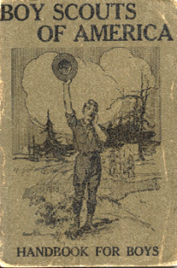
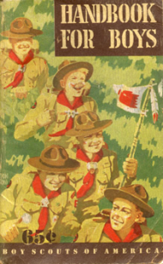
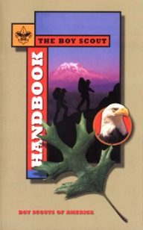
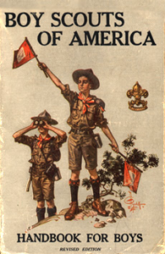
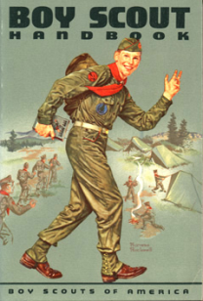
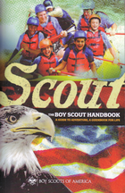
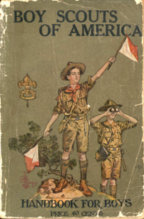
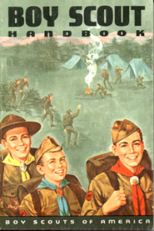
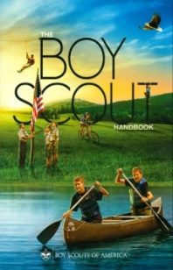
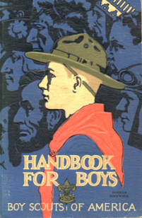
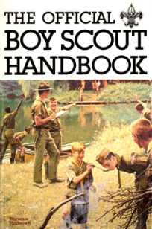
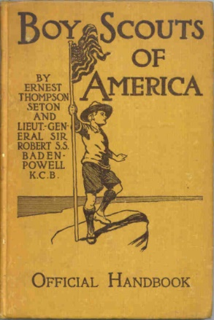
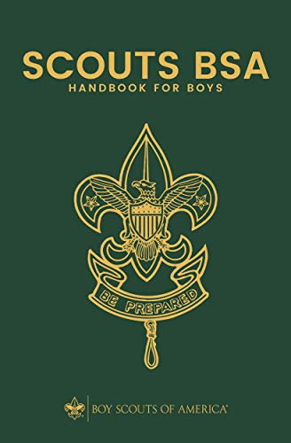
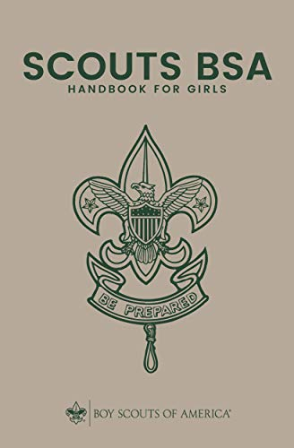
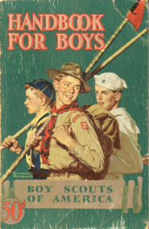
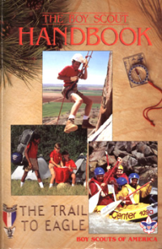
Boy Scout Handbook
Official handbook of the BSA – Considered Scouting’s “Bible”
It is a descendant of Baden-Powell's original handbook, Scouting for Boys
1st Edition
14th Edition

Slide 18
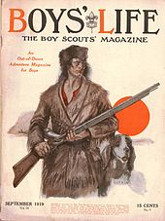
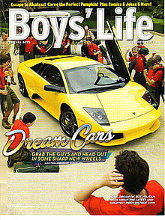
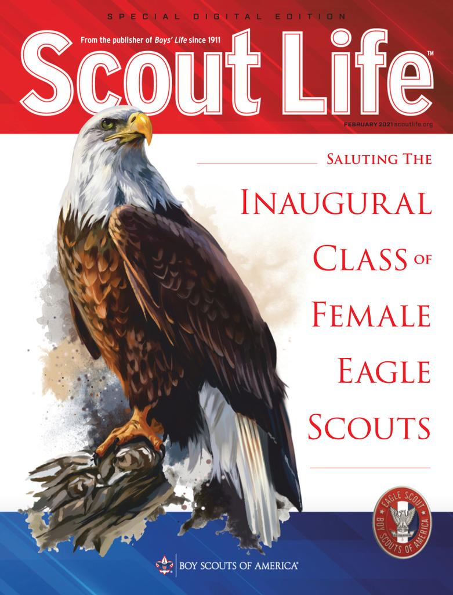
Boys’ Life Magazine (Jan 2021 – Scout Life)
Monthly magazine of the BSA.
Two demographic editions. Often have the same cover, but contents tuned to the target audience
The first issue published on January 1, 1911
Bought by BSA in 1912

Slide 19
Evolution of Scouting’s Programs
Boy Scouts - 1910
Cub Scouts – 1930, but experimental until 1934
Explorer Scouts - 1949
Venturing - 1998

Slide 20
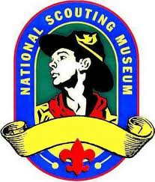
National Scouting Museum
Moved from Texas to Philmont, New Mexico
17 Deer Run Rd. Cimarron, NM 87714
Opened in May 2018
Displays
Artifacts relating to the history of the Boys Scouts.
Paintings by Norman Rockwell and Joseph Csatari
Artifacts of Arthur Rose Eldred, first Eagle Scout.
Man made mountain structure with virtual-reality features; to simulate bike-racing through the mountain or kayaking down its waters.

